Slide 2
Module 3: Hepatitis C Treatment

Slide 3
AIVL thanks the Australasian Society of HIV, Hepatitis and Sexual Health Medicine (ASHM), The Kirby Institute, Gilead Sciences and AbbVie Australia for support and guidance in developing this module. Additional thanks go to Gilead Sciences for enabling the rollout of the training.

Slide 4
Learning Objectives
By the end of this session, you will know:
How is hepatitis C treated now
What you should expect on treatment
What the benefits are of getting treated
How you can protect yourself from re-infection

Slide 5
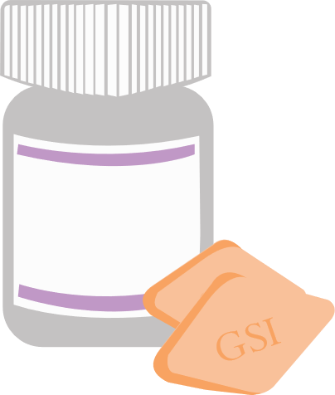
How has hepatitis C treatment changed?
OLD
NEW
Interferon
DAAs
Side effects
Fewer side effects
24 weeks
8-12 weeks
60-70% cure
95 % cure!

Slide 6
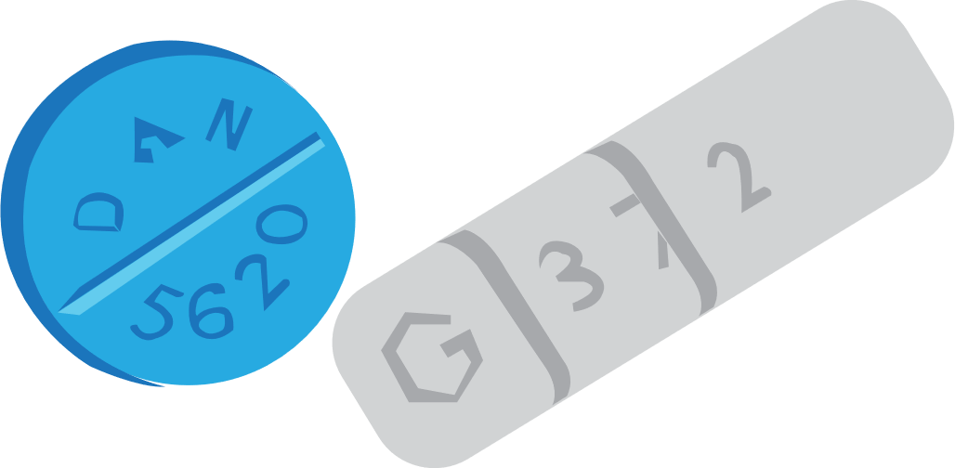
What to expect while on treatment
Fewer side effects – you might even start to feel better after a few weeks
Regular visits with a doctor or nurse
Some other medications can’t be used when on DAAs – ask your doctor
Remember to take your medications every day and for the full course

Slide 7
Who can get treated ?
Drug use does not exclude people from treatment!
Talk to your local user group if you need help with problems getting in the way of treatment

Slide 8
What happens after a cure?
Feel less tired and have more energy
Liver inflammation reversed
Cure does not protect you from other strains of Hep C –
always practice safe injecting

Slide 9
Scenario
You’ve got a friend who has hepatitis C but they don’t want to get treated because they’ve heard it’s hard and makes you sick….
What would you say about what new treatments are like?
What do you recommend they do?

Slide 10
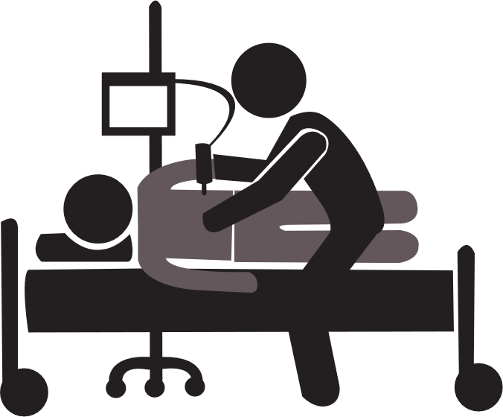
How to get tested and treated for Hep C
Ask your doctor or nurse for a blood test
If your tests come back positive, ask to start treatment
To find out more about the
health of your liver,
ask for a fibroscan
For more info, contact your local drug user organisation

Slide 11
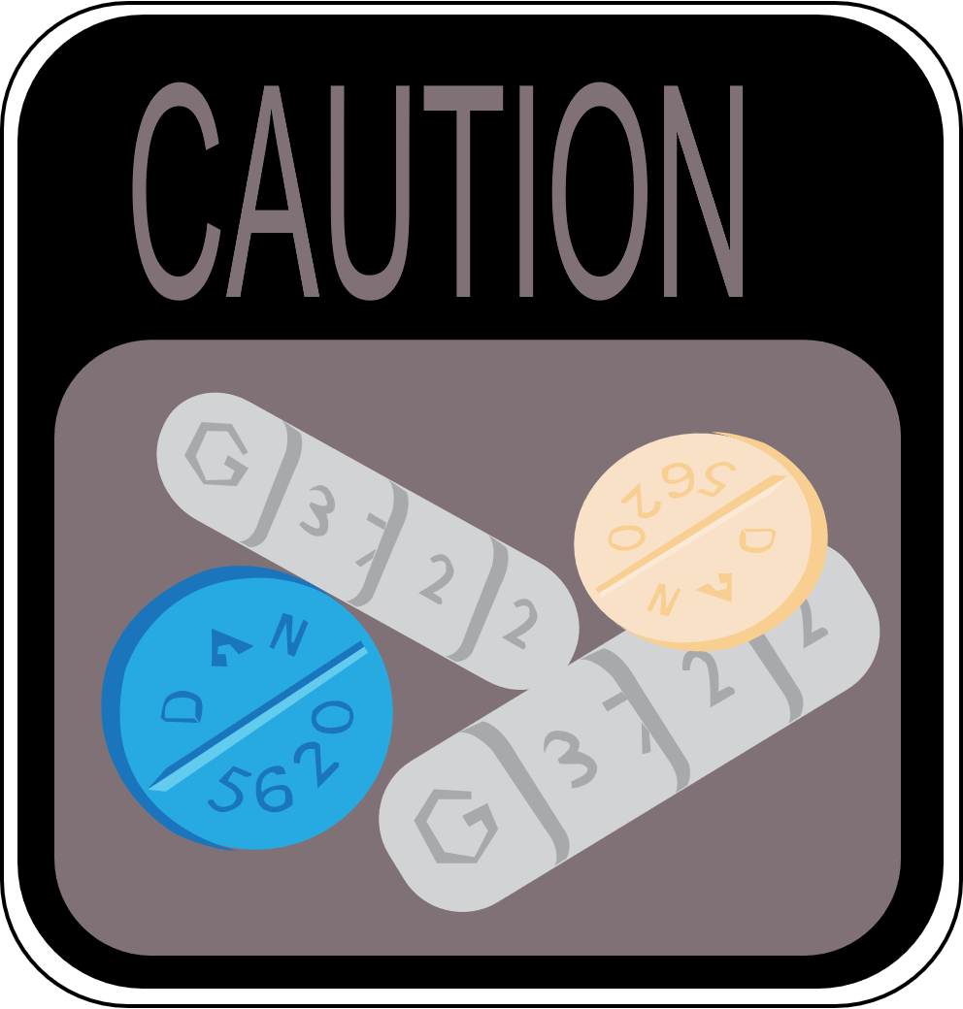
Keeping healthy if you’re not
ready for treatment
Be careful of drugs like benzos
Exercise
Practice safe injecting
Reduce your alcohol intake
Eat a healthy diet

Slide 12
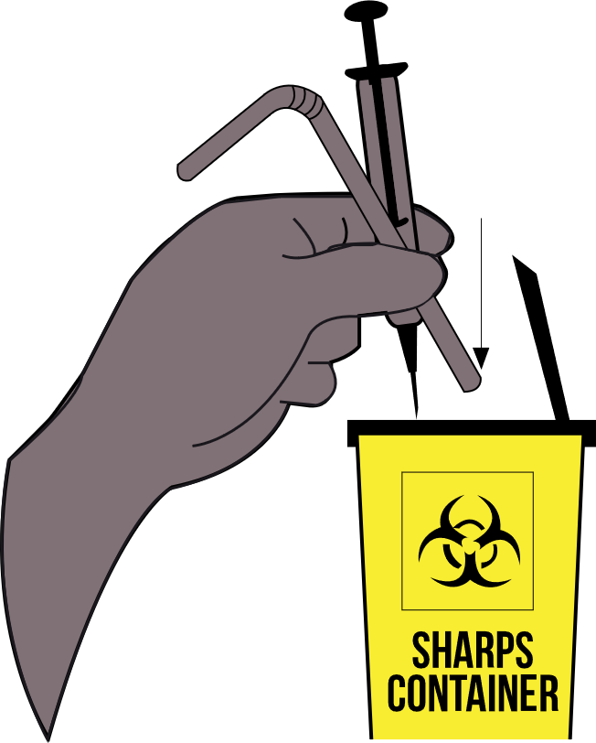
How to protect yourself from hepatitis C
Wash hands and injection site with soap and water
Always use a new needle and syringe
Keep and use your own equipment
ie. spoon, tourniquet
Always dispose of used equipment safely

Slide 13
Summary
Hepatitis C testing and treatment in 5 points
Hepatitis C is a virus found in blood that causes inflammation of the liver
Sharing injecting equipment is the most common way of transmitting hepatitis C
A blood test can check if you have hepatitis C now or in the past
DAAs cure hepatitis C in 95% of people and reverse liver inflammation
There is no vaccination for hepatitis C. You can protect yourself with a new fit for every hit

Slide 14
Scenario
You’ve got a friend who has just finished treatment….
What would you advise them to do to make sure they don’t get re-infected?

