Slide 1
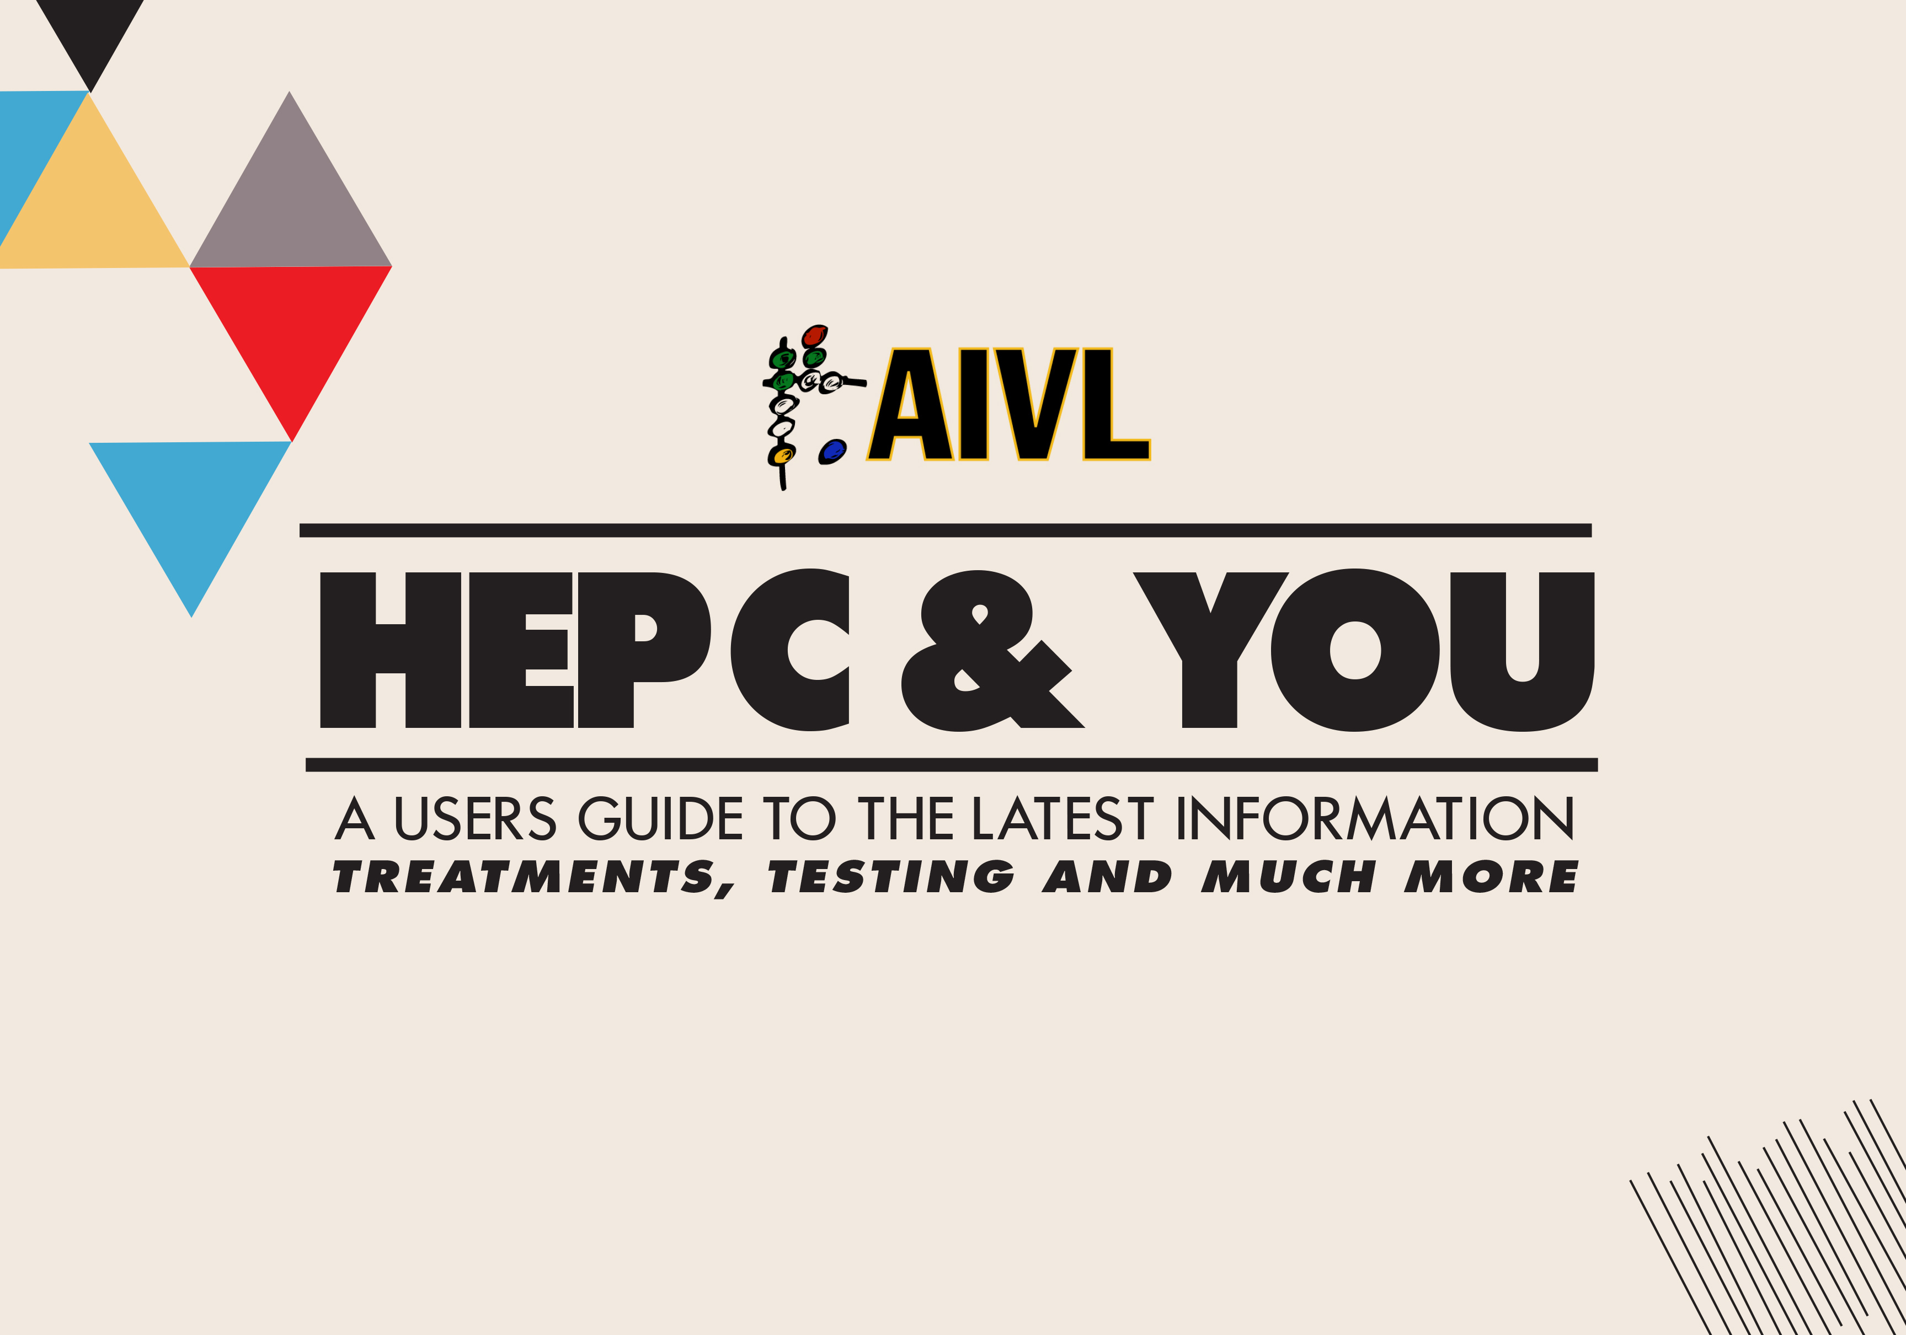

Slide 2

Module 2:
Hepatitis C Testing

Slide 3
AIVL thanks the Australasian Society of HIV, Hepatitis and Sexual Health Medicine (ASHM), The Kirby Institute, Gilead Sciences and AbbVie Australia for support and guidance in developing this module. Additional thanks go to Gilead Sciences for enabling the rollout of the training.

Slide 4
Learning Objectives
By the end of this session, you will know:
What is hepatitis C and how you get it
How you can protect yourself from hepatitis C
What tests you should get for hepatitis C

Slide 5

What is hepatitis?
“HEPAT”
“ITIS”
+
‘Hepatitis’ means having an inflamed (damaged) liver
Liver
+
Inflammation

Slide 6
What is hepatitis? (cont’d)
Healthy liver Liver affected by fibrosis Liver affected by cirrhosis

Slide 7




ABC’s of Hepatitis
Hep A
Hep B
Hep C
How do you get it?
Contact with blood of a person with Hep C, like sharing injecting or tattooing equipment
Most common type of viral hepatitis for people who inject drugs
Contaminated food and water
Contact with blood of a person with Hep B, like sharing tattooing or injecting equipment
Prevention/cure
Prevention/cure
Vaccine
Vaccine and Pills
Pills

Slide 8








How do you get Hepatitis C?
Sharing used injecting equipment
Sharing used tattooing, piercing and scarification equipment
Sharing used straws and pipes
Sharing razors and
toothbrushes
Unprotected sex (when blood is involved)
It’s impossible to tell by sight if blood has the Hepatitis C virus, so the safest thing to do is never share equipment!

Slide 9






What are some signs that you might have Hepatitis C?
Weakness / feeling tired
Loss of appetite
Red colouring
on your palms
Spider-like blood vessels on the chest
Trouble stopping bleeding after injecting
Breast enlargement
in men

Slide 10
Activity
Scenario:
You’ve got a friend who isn’t sure if they have hepatitis C and doesn’t really know what it is…
  How would you describe Hepatitis C to your friend, what it does to your body and how they can protect themselves?

Slide 11







Why get tested and cured?
Get tested and cured to:
Around half of all people
who inject drugs
live with hepatitis C
So you know if you have Hepatitis C or not
Feel better
Prevent more damage
to your liver
Prevent transmitting the
virus to someone else
11

Slide 12

Testing for Hepatitis C
Blood tests are used to see if you have hepatitis C
Blood tests look for two things:
Hep C Antibody
Tells if you have EVER had hepatitis C
Hep C RNA
Tells if you have hepatitis C NOW

Slide 13

Do I have Hepatitis C now?
Ab +
RNA +
&
You have Hepatitis C NOW
Ab +
RNA -
&
You have had Hepatitis C in the PAST but not now
Ab -
RNA -
&
You have NEVER had Hepatitis C

Slide 14
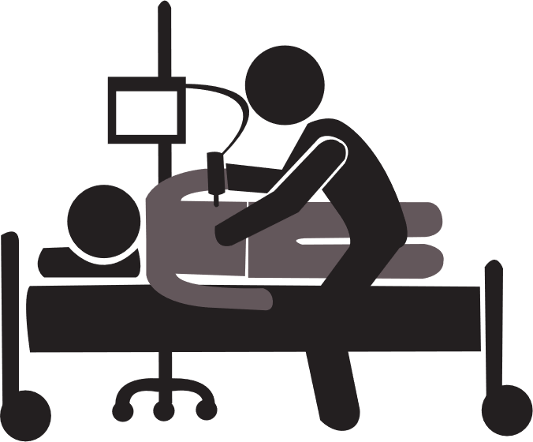
Recap: What are the tests for liver disease when hepatitis C is present
Liver Function Tests (LFT) see how well your liver is working
A Fibroscan tells how much scarring is on your liver

Slide 15
What strain of Hepatitis C do you have?
There are several strains of Hepatitis C called ‘genotypes’
All genotypes can be cured
Your doctor or nurse will choose the best treatment for you depending on your genotype and whether you have liver damage
There are 6 genotypes:
Genotype 1 Genotype 4
Genotype 2 Genotype 5
Genotype 3 Genotype 6
Most common genotypes in Australia

Slide 16


How much of the virus is there?
A viral load blood test measures the amount of hepatitis C in your blood
8
2
If you have hepatitis C now, the viral load test result is a number
13
If the result is undetectable, it means you don’t have hepatitis C now
The doctor (or nurse) might arrange repeat blood tests to check
if your viral load changes over time

Slide 17
Summary
Hepatitis C testing and treatment in 5 points
Hepatitis C is a virus found in blood that causes inflammation of the liver
Sharing injecting equipment is the most common way of transmitting hepatitis C
A blood test can check if you have hepatitis C now or have had in the past
There is no vaccination for hepatitis C. You can protect yourself with a new fit for every hit

Slide 18
Activity
Scenario:
You’ve got a friend who is worried that they may have contracted Hepatitis C but doesn’t know how to find out….
  How can they find out for sure? How would you describe Hepatitis C testing to them?

