Slide 1
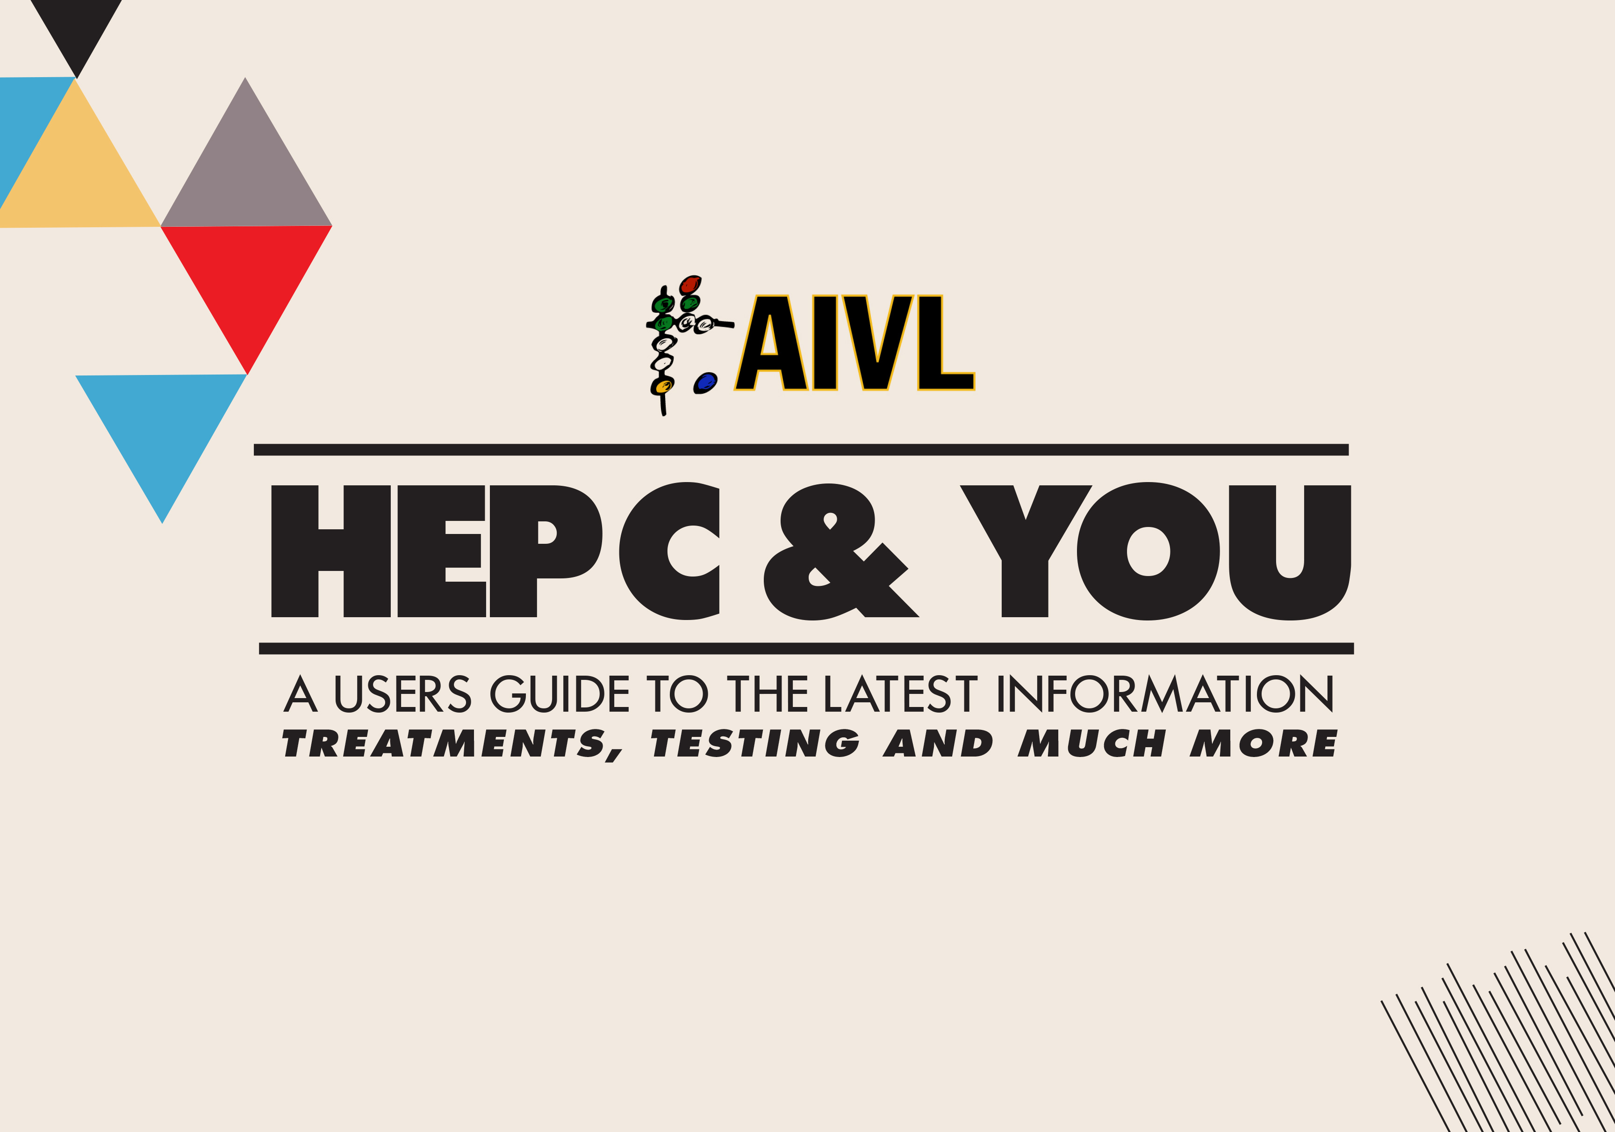

Slide 2

Module 1: Liver Health

Slide 3
AIVL thanks the Australasian Society of HIV, Hepatitis and Sexual Health Medicine (ASHM), The Kirby Institute, Gilead Sciences and AbbVie Australia for support and guidance in developing this module. Additional thanks go to Gilead Sciences for enabling the rollout of the training.

Slide 4
Learning Objectives
By the end of this session, you will know:
Why your liver is important
What causes liver disease
How you can test the health of your liver
What you can do keep your liver healthy

Slide 5
Activity
What do you know about the liver?

Slide 6


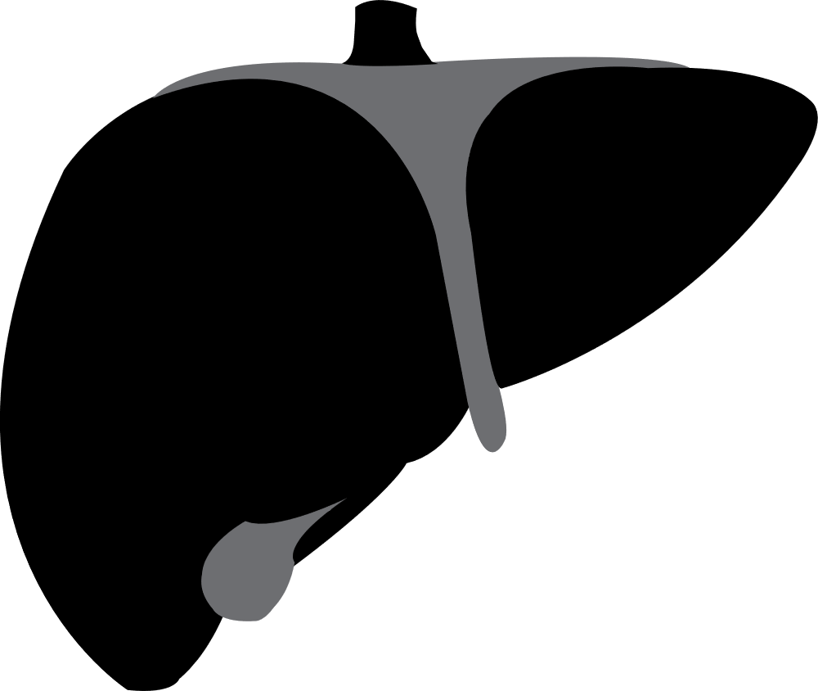


Where is the liver and what does it do?
Where?
The liver is in the upper right-hand corner of the your abdomen, just under your ribs
What?
The liver:
cleans the blood of toxins
breaks down the food you eat
builds protein
You can’t live without a liver

Slide 7
Scenario
You’ve got a fiend who asks why they should care about their liver….
What would you tell your friend?

Slide 8
What is liver disease?
Healthy liver Liver affected by fibrosis Liver affected by cirrhosis

Slide 9


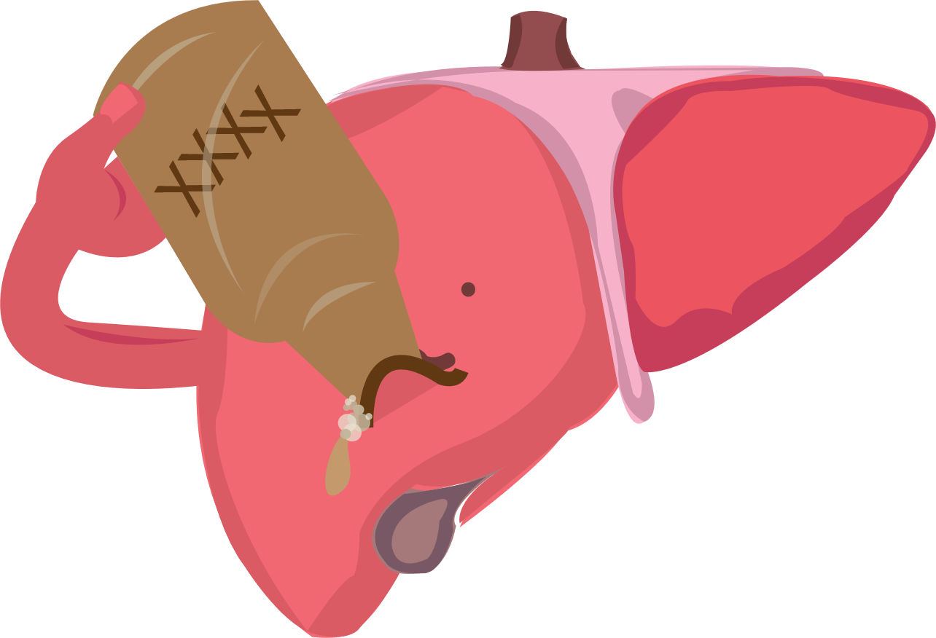




What causes liver disease?
Causes of liver disease
If you have liver disease, things that make it worse are:
Being overweight
Old Age
Drinking too much
Fatty liver
Hepatitis C
Co-infection with HIV
Drinking alcohol

Slide 10
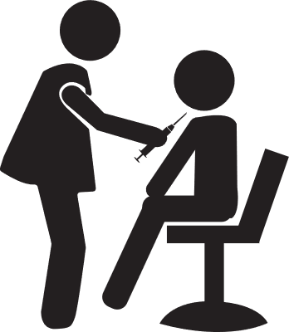
What are the tests for liver disease?
Liver Function Tests (LFTs)
If you liver is damaged, it won’t work properly
LFTs are blood tests
They look for chemicals called liver enzymes
High levels of these enzymes tell your doctor that your liver may be damaged

Slide 11

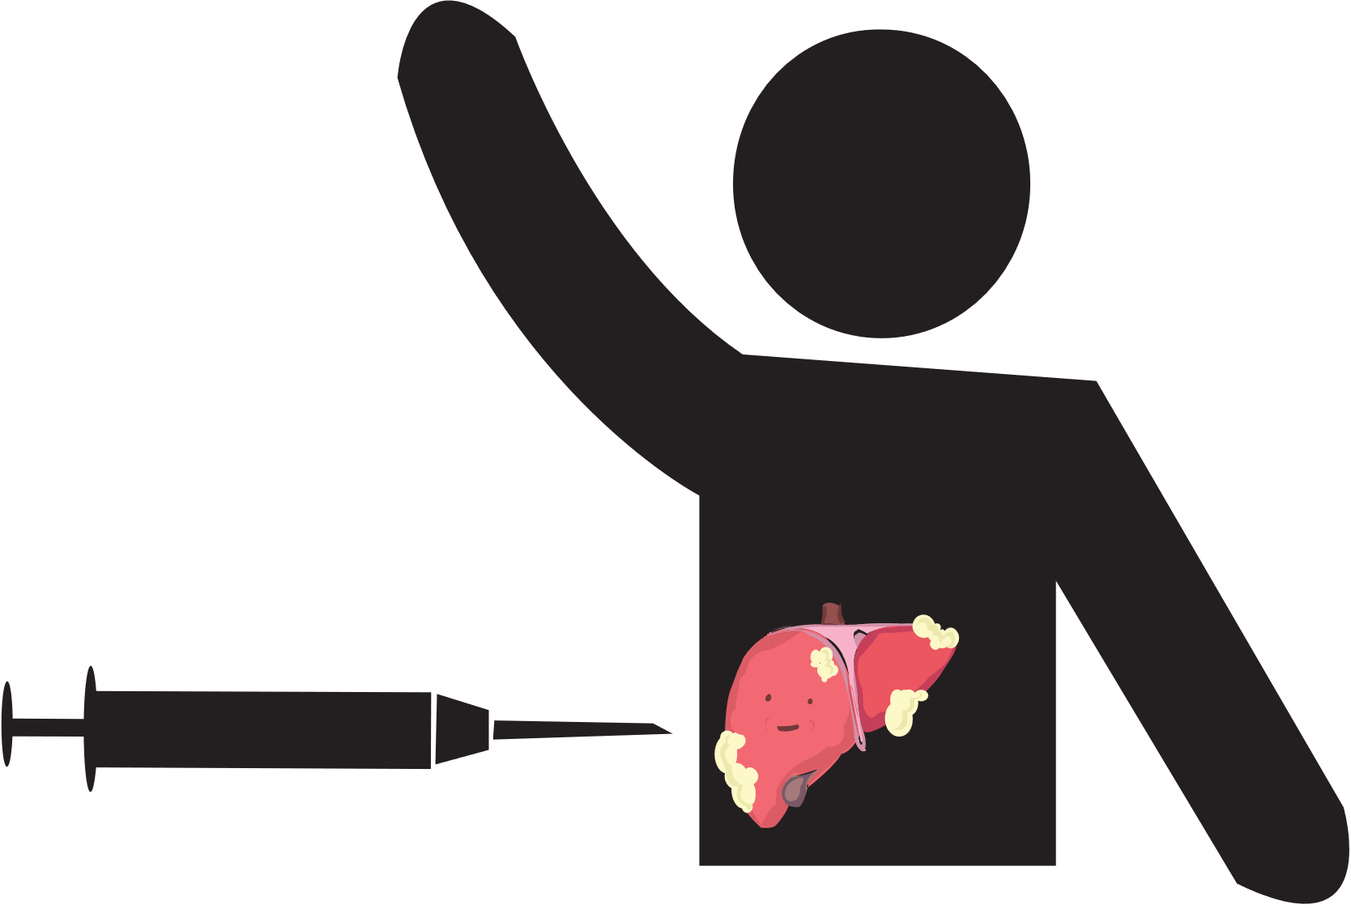
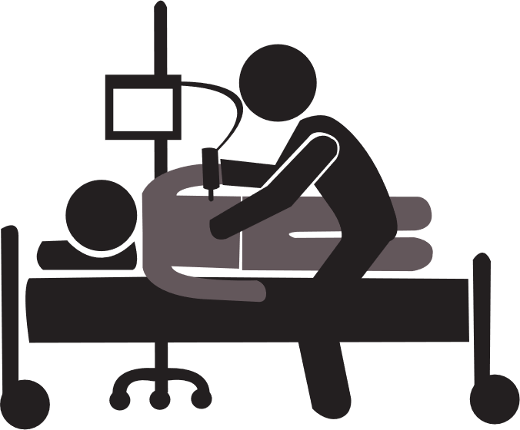
What is the test for liver scarring?
Now =
Past =
Liver biopsy
Fibroscan
measures how scarred the liver is
It’s a free, quick and painless test

Slide 12
Scenario
Your friend is worried that their liver might be damaged…..
How would you describe why the liver important?
How would you describe liver damage?
What tests do they need to check for liver damage?

Slide 13




How to keep your liver healthy
Exercise
Cut back on how much alcohol you drink
Eat healthy
Get tested for hepatitis C

Slide 14
Summary
Liver health in 4 points
The liver is important for filtering and removing toxins form the blood
Drinking too much alcohol and infection with hepatitis C can damage the liver and caused scarring over time
A fibroscan is a quick, painless test that shows if the liver is damaged
Keep your liver healthy by eating right, exercising and getting tested for hepatitis C

Slide 15
Activity
Liver health teach back
Scenario: What do you recommend that a friend do to:
  Find out more about liver health
  Keep their liver healthy

